Slide 1

Reading Strategies for Information Systems
By:
Muhammad Iffan Ramadhan 2117020036
Putri Hanifah 2117020062

Slide 2
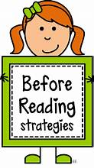
Outline
Introduction to Information Systems
Types of Information
Objectives of Reading Information Systems
Reading Strategies
Understanding Key Terms and Concepts
Overcoming Challenges

Slide 3

Introduction to Information Systems
“Definition”
“Components”
“Importance”
Integrated systems for managing and processing information
Hardware, software, databases, procedures
Efficiency, adaptability, decision-making, optimization

Slide 4
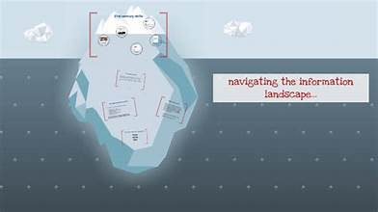
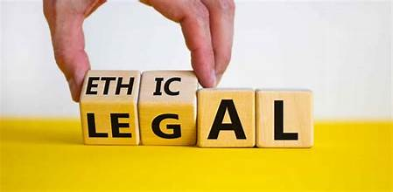


The Role of
Information Literacy
Navigating information landscape
Critical evaluation
Holistic skill development
Ethical application

Slide 5


Data vs Information
Data
Information
Raw, unprocessed elements without context
Data processed into structured, meaningful form

Slide 6
Information Structure
01.
Organization and storage
Information Structure
02.
Hierarchical arrangement
03.
Relational links

Slide 7

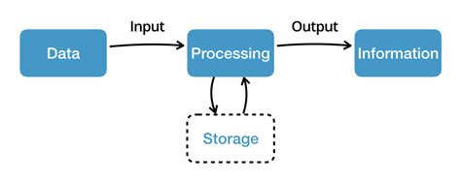
Information
Processing Stages
Collection and input
Processing and transformation
Storage and retrieval
Output and presentation

Slide 8

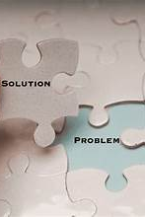
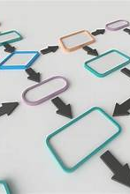
Objectives of Reading Information Systems
Enhancing decision
making efficiency
Identifying User Needs
Finding solutions

Slide 9


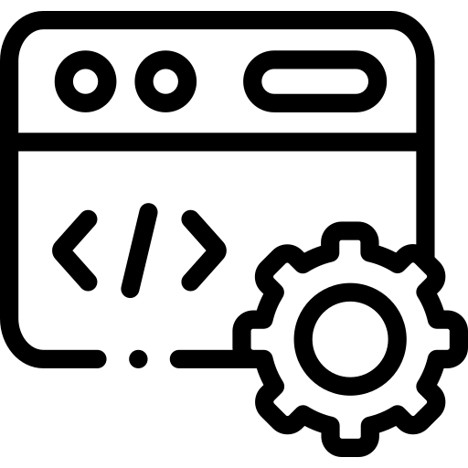

Reading Strategies
01. Skimming.
02. Scanning.
Quick overview of main ideas
Searching for specific details
03. In-depth reading.
Comprehensive understanding

Slide 10


Understanding Key Terms and Concepts
Technical terms
Basic concepts.
Enables effective communication
Provides foundational framework

Slide 11

Overcoming Challenges
Handling technical language
Using additional resources
Communicating with IT professionals

Slide 12
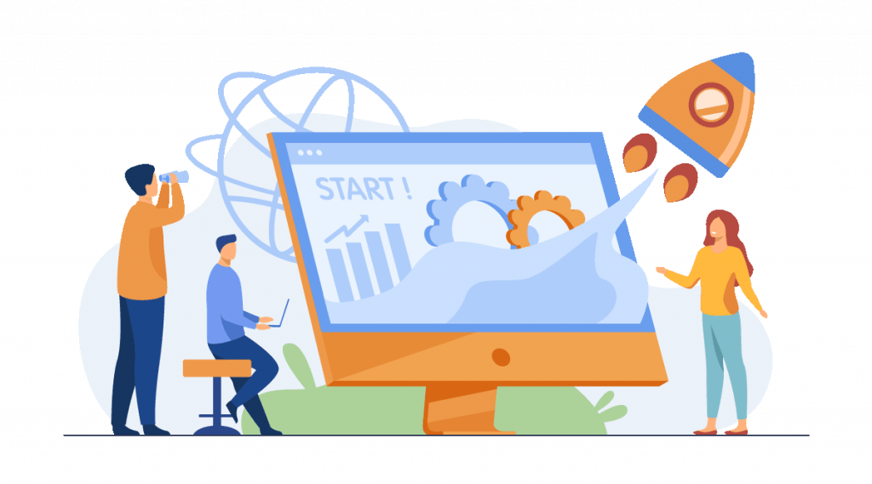
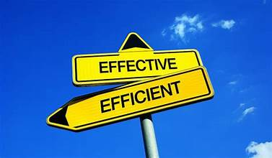
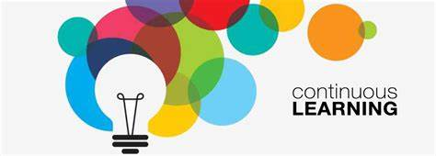
Summary
Tailored strategies enhance information utilization
Combination of techniques for optimal effectiveness
Continuous learning mindset to navigate complexity

Slide 13

Thank You.

